Slide 1
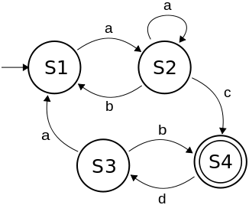
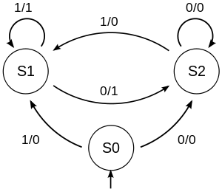
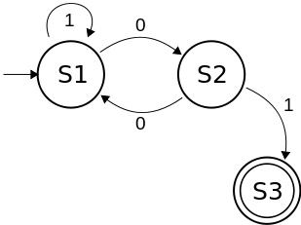
Finite state machine
Lizaveta Kemerava

Slide 2



States of the FSM is the amount of money still needed, and the input is the next coin

Slide 3
That is so cool! How do we encode it?
Very simple, you can your own machine!
Just this one command is needed after downloading the code from the project repository at https://github.com/kemerava/CompSystemsFSM
And if you want to be able to test the code or use the debugger, it is as simple as
‘$make’ to run the sample machine,
‘$make debug’ to run that machine in debug mode,
‘$make tests’ to run the tests
‘$make custom transitions=<filename> inputs=<filename>’ to create your custom machine
‘$make custom_debug transitions=<filename> inputs=<filename>’ to create your custom machine in debug mode

Slide 4
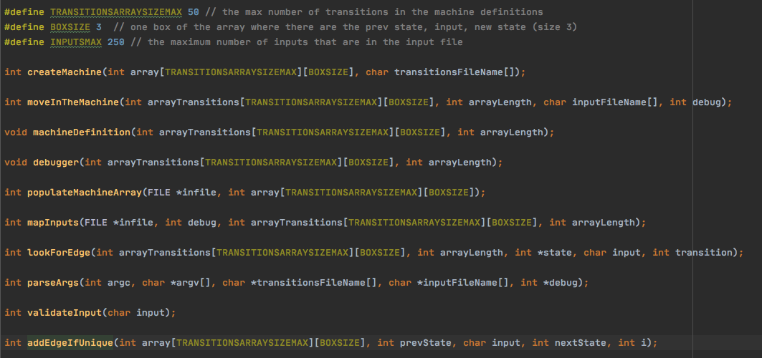
Behind the scenes

Slide 5
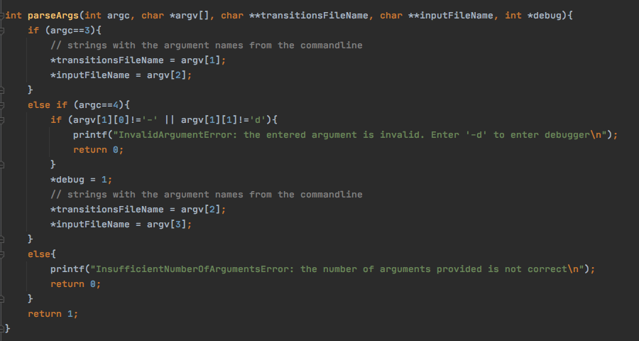

Slide 6
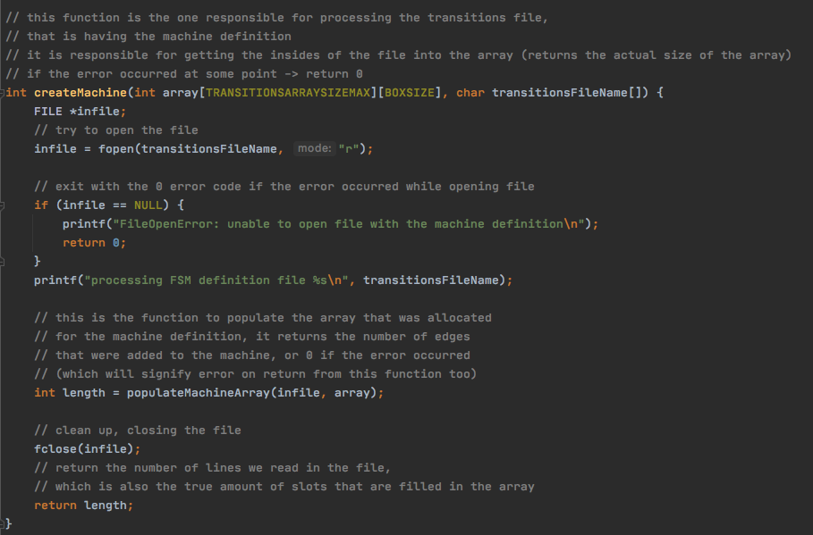

Slide 7
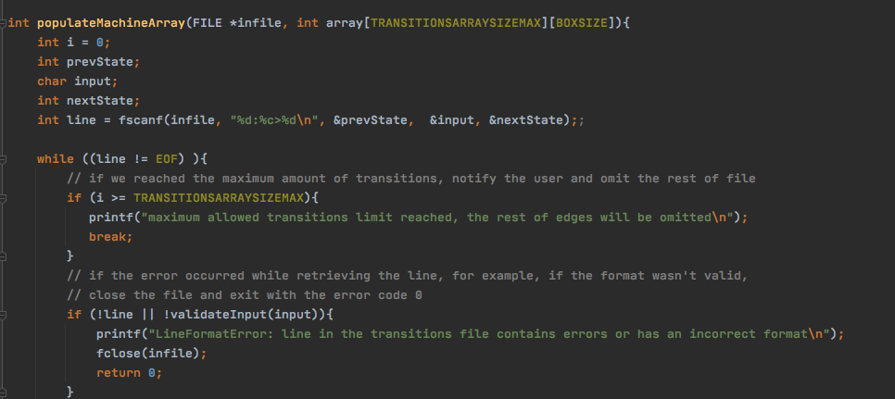

Slide 8
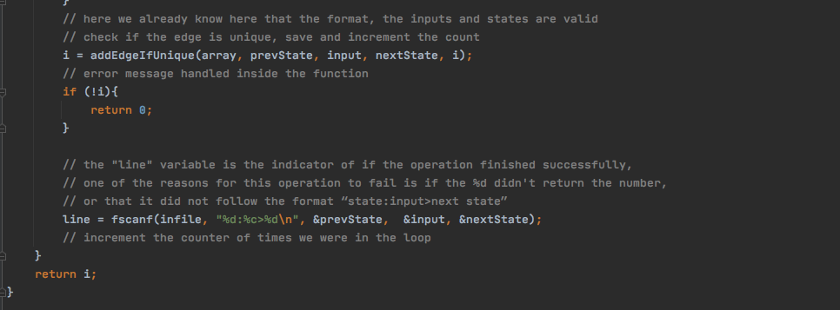

Slide 9
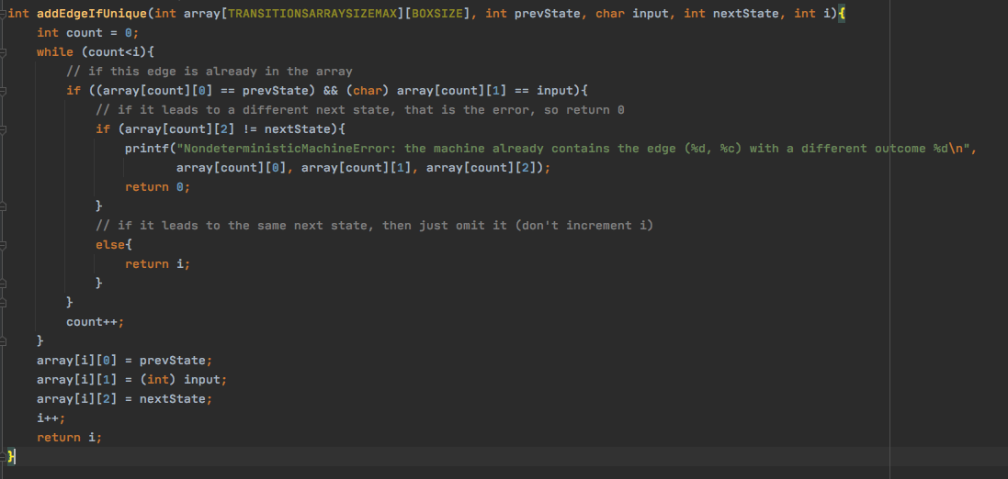

Slide 10
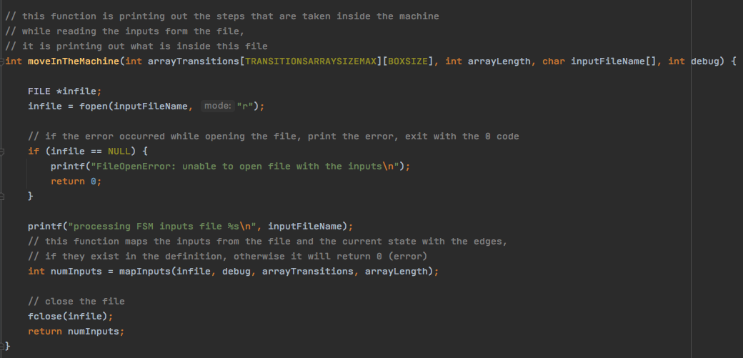

Slide 11
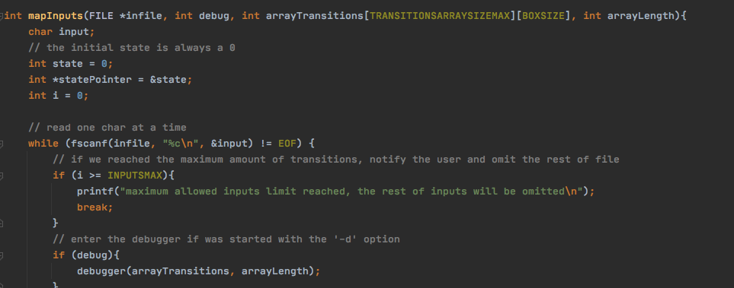



My favorite part! Debugger!

Slide 12
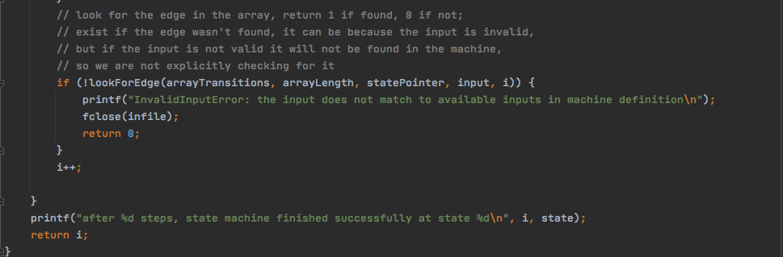

Slide 13
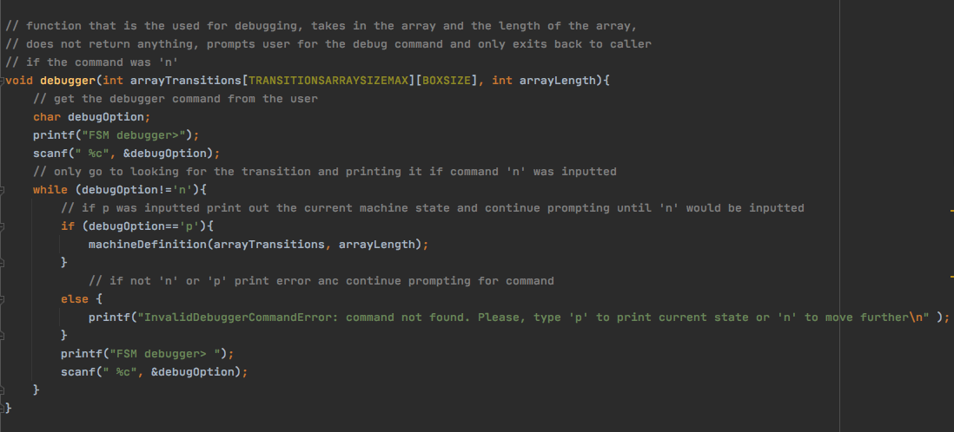

Loved coming up with the descriptive error names!

Slide 14
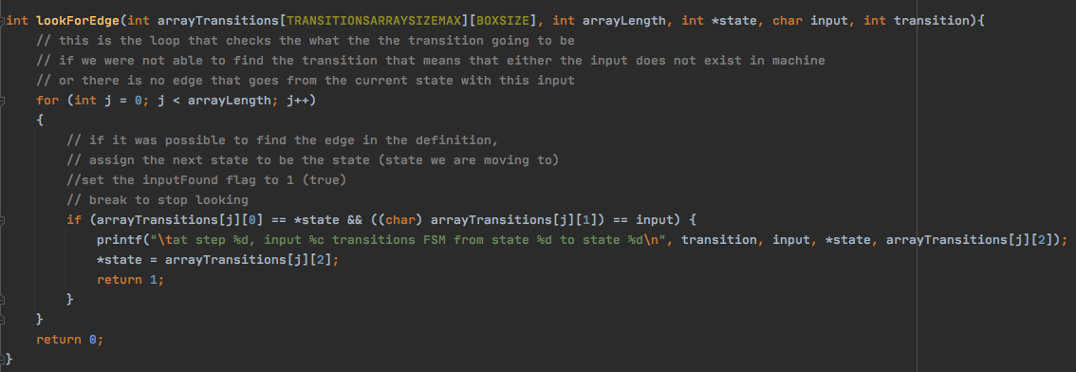

Slide 15
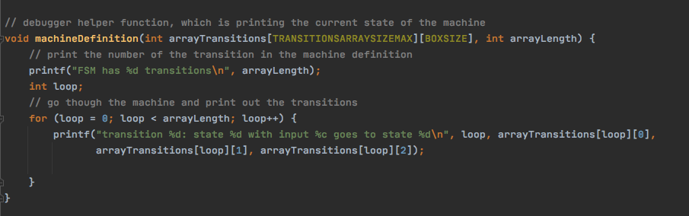
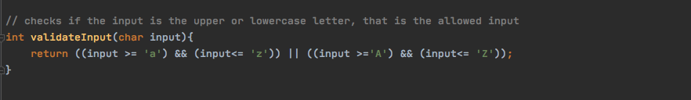

Slide 16
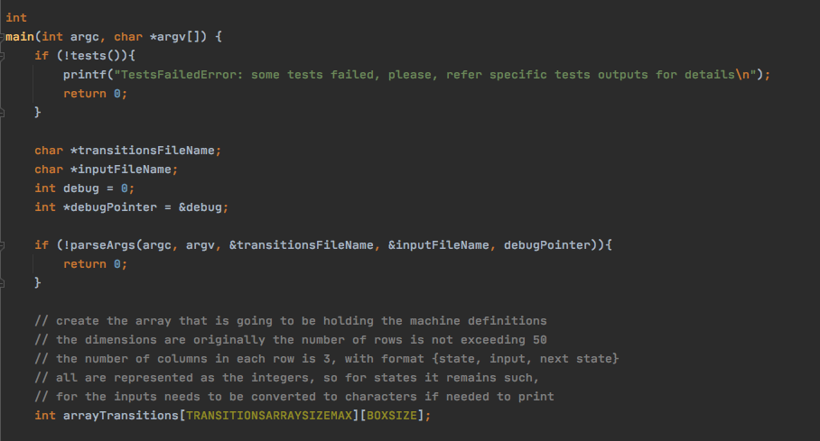

Slide 17
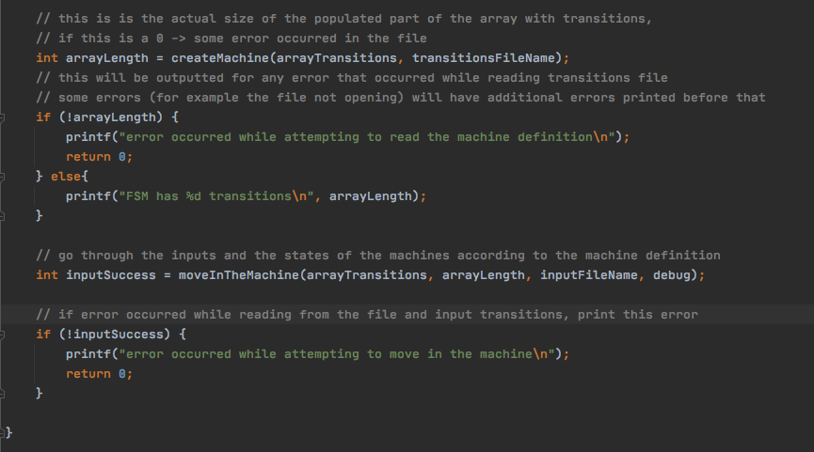

Slide 18
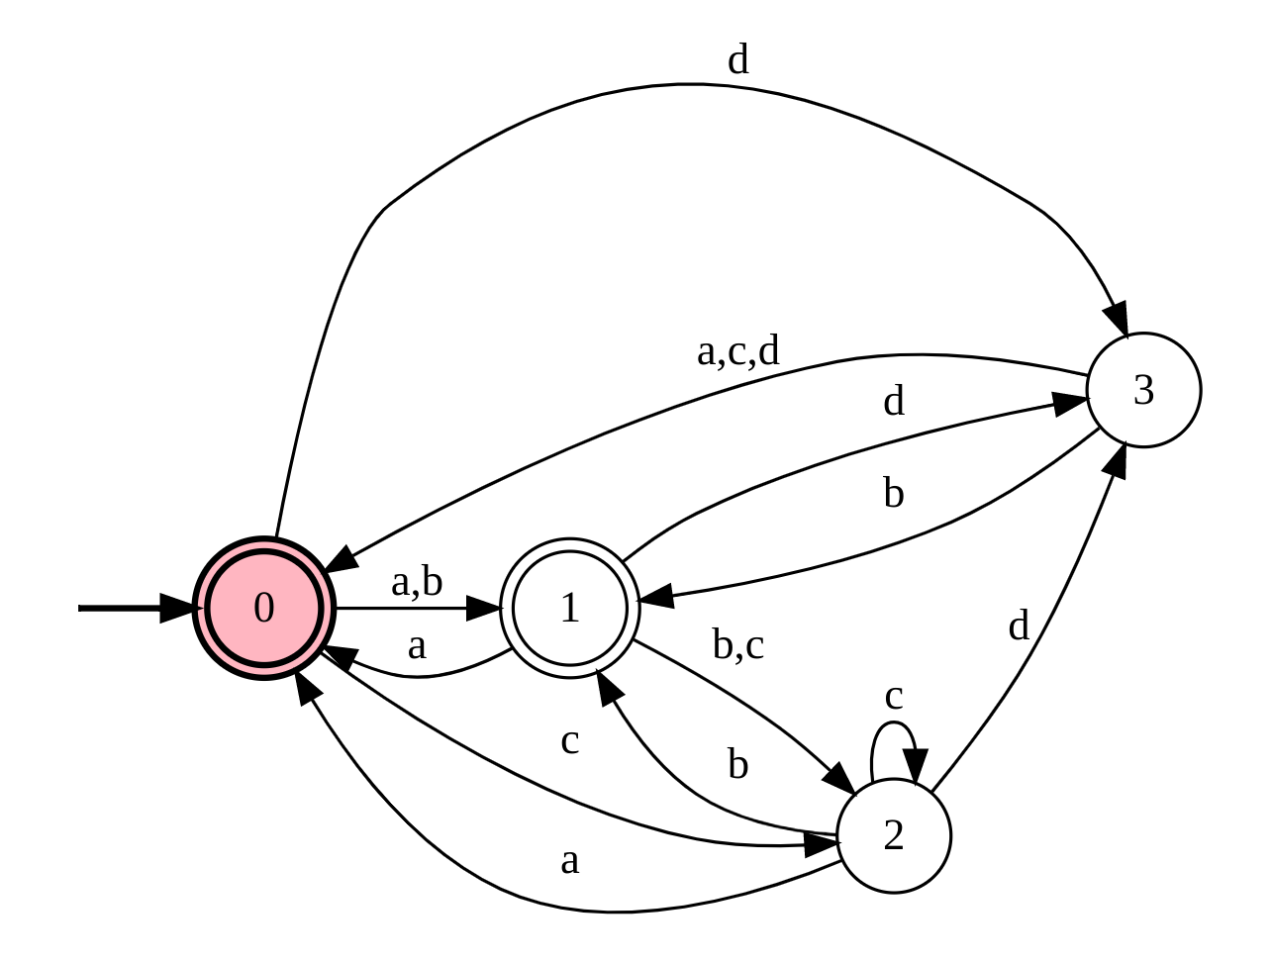
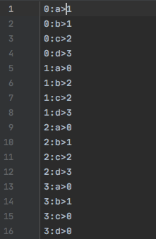
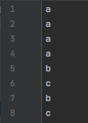
Machine we are going to build now
This is a finite state machine with 16 edges. The definition of it is available in the transtitions.txt and the sample inputs are in inputs.txt (screenshots of the files are available on the left)

Slide 19
Now lets put this program to test
12 tests available in make.
24 unit tests available in tests.c
To start make tests, run ‘$make tests’.
Unit tests are ran before every time running main.
All the necessary files are provided in the project.
The tests target program’s response to various edge cases and error prompting scenarios.
Let’s look at results of some of the tests…

Slide 20
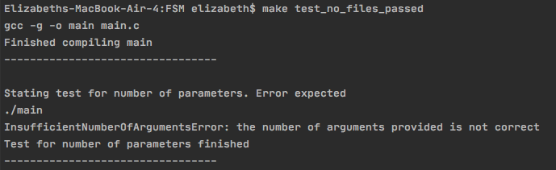
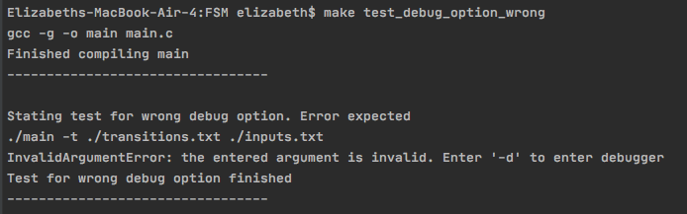
Test results for invalid or invalid number of command line arguments

Slide 21
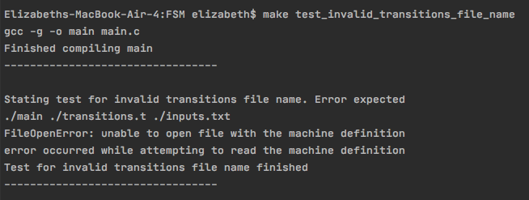
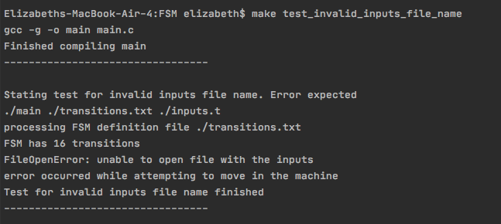
Test results for the invalid file names

Slide 22
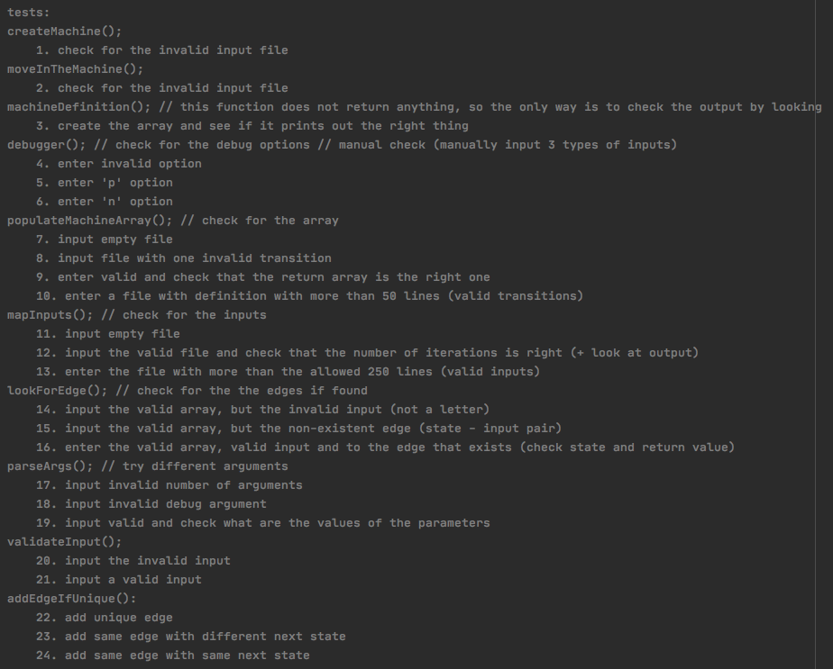
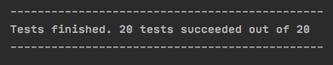
These functions are void, so check by looking at the output, therefore they are commented out in tests()

Slide 23
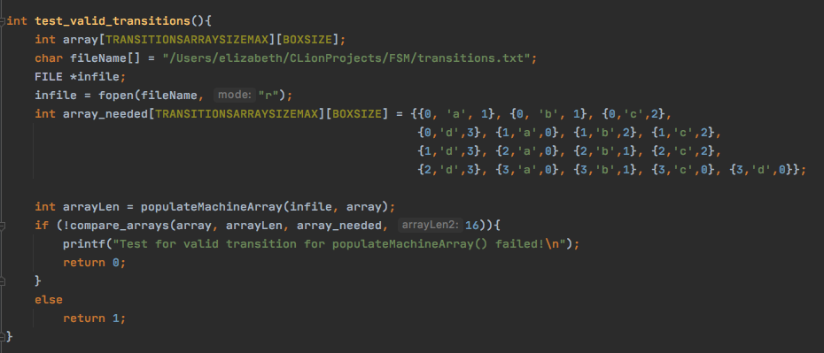
Arrange
Act
Assert

Slide 24
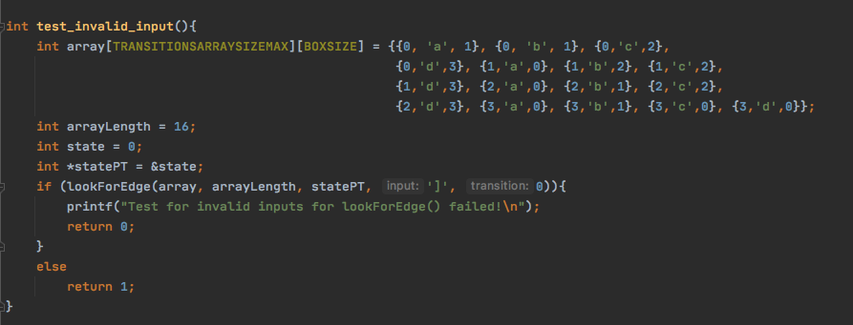

Slide 25
As in every project there were some challenging parts and most fun parts
Learning to make good design choices
Learning to break down functions efficiently
Learning to make tests with good coverage
Loved building a debugger
Had fun coming up with error names and custom messages
Enjoyed working with C (especially with pointers)

